Slide 1


University of Basrah Al-zahra college of medicine
Ministry of higher Education and Scientific Research
Academic year 2025-2026
1st year. Semester S1
Foundation of Medicine
Lecture: 2 Session: 1 Date: 23/November/2025
Assisted prof.
Dr. Mazin Abed Hazza

Slide 2

Art of history taking
Assisted prof.
Dr. mazin Abed Hazza
MD, DM. FICMS, CABM. FICMS-cardiology

Slide 3
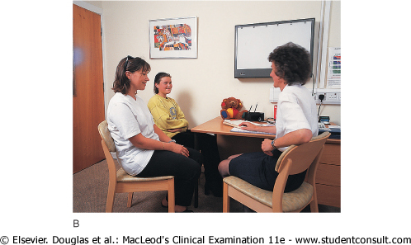
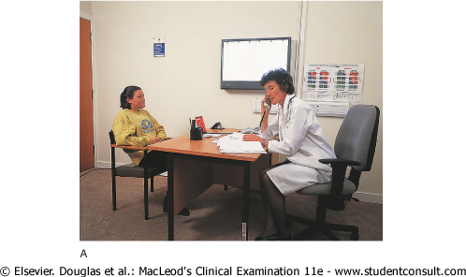

Slide 4
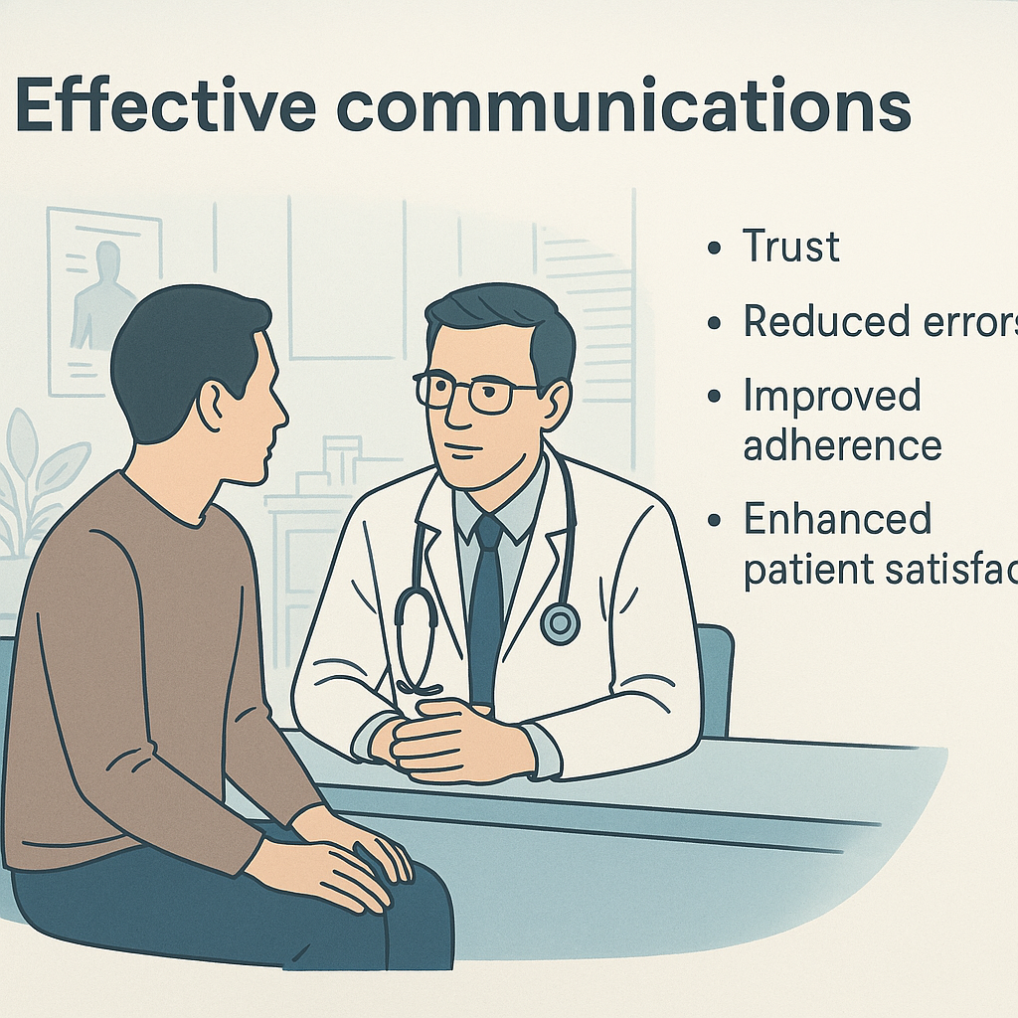
Effective communications
It build trust
Reduces error
Improve adherence
Enhance pateint satisfaction

Slide 5

Principles of good communications
Knock, greet and introduce yourself
Maintain appropriat eye contact
Sit down = showes you are not hurry and giving time
Use pateint’s name.
Use open body language

Slide 6
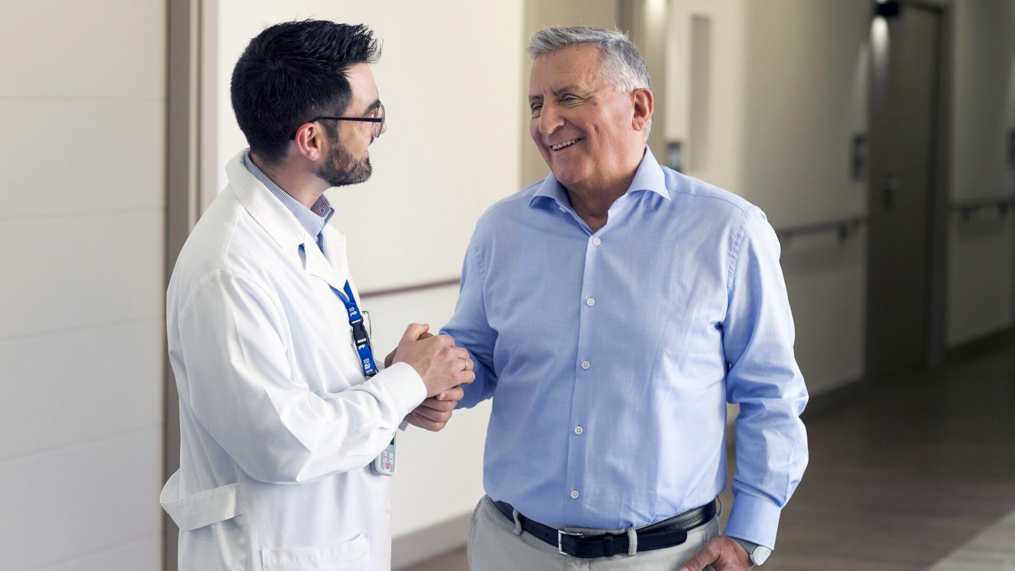

Slide 7
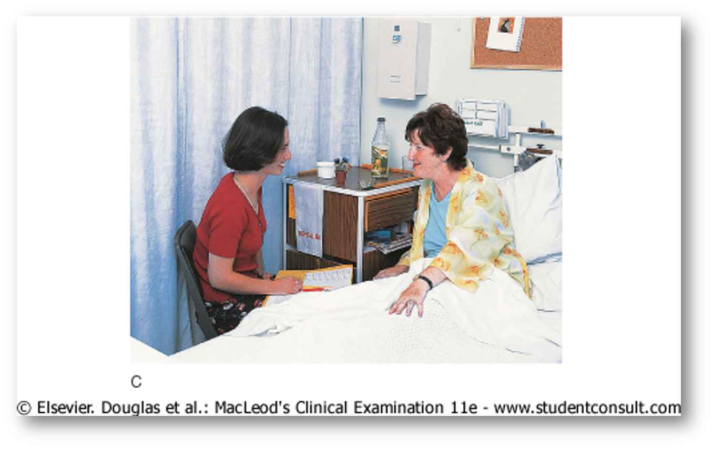
Sit down = showes you are not hurry and giving time

Slide 8

Maintain appropriat eye contact

Slide 9

Open-ended questions
What brings you in today
How I can help you
Then followed targeted questions

Slide 10

Active listening
Nod, maintain eye contact
Do not interrupt in the first 60 seconds.
Use verbal cues : I understand, go on, I see

Slide 11

Empathy
Show understanding of feelings
I can see this has been stressful to you.
That must be paiful

Slide 12
Empathy
Does not mean agreeing; it means understanding

Slide 13


Slide 14


Slide 15


Slide 16


Slide 17
Avoid medical Jargon
Use simple clear language
Say high blood pressure in steed of hypertension.
Heart ultrasound instead of echocardiogram
Lewetic disease instead of syphlis
Neoplasia instead of cancer

Slide 18

Clarify and summerized
This is at the end of the review

Slide 19
Cultural and personal sensitivety
Respect the patient background, beleifs and preferences
1
Ask pefore touching
2
Consider gender preferences for examination.
3

Slide 20
Share decision-making
Explain options clearly
Risk
Benefit
Alternatives
Ask the patient what do you prefer?

Slide 21
Confidentiality
Every thing we discuss stays private unless you give permission or if safety at risk.

Slide 22
Common mistake that should be avoided
Interrupting too early
Not listening to fears and concerns
Using too much medical termenology
Rushing of the patient
Making assumptions
Not checking the patient understanding.

Slide 23
Tips in difficuilt situations
Angry patient==== stay calm, acknowlege feelings
Crying patient== offer tissue, pause, slow empathy.
Talkative patient==== I want to make sure we have time to adress your main concern
Silent patient===use gental prompts “ take your time..can you tell me more?

Slide 25
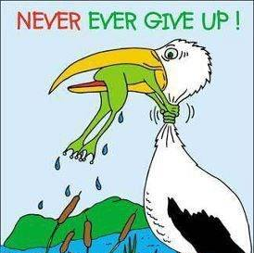
The end
Thank you

